Slide 1

TFR – Technical Spike – Good RESTful Services
30th March 2017
Michele Sacerdoti
OMDC

Slide 2
Abstract
API Enablement project provided a list of rules to create good RESTful services
These rules match the industry standards for RESTful APIs and are considered to be strategic directions for NCAF REST Layer
Rules apply not only under the API enablement project scope. These are industry standards and should be applied in any REST layer according to the NCAF principles and architectural templates
Benefits of adopting good RESTful APIs as the Middle Layer include re-usability, security, making the middle layer lightweight, keeping client/server interaction stateless
Benefits of adopting industry standards as the corporate guidelines and best practice improve re-usability, maintainability, knowledge sharing and security

Slide 3
Agile Definition
User Story definition:
  “As a developer I want to have an agreed pattern for developing good RESTful APIs so that I can get a shared approach across the estate to create atomic stateless services matching the industry standards and the strategic Nationwide directions, and therefore improving re-usability, security, speed and maintainability”

Slide 4








Three Layer Architecture
NCAF ATs depicts a typical three-layer architecture whose layers are:
  Presentation Layer: Hybrid/web client
  Middle Layer: RESTful Layer acting as a service agent, performing security tasks, authentication, authorization, logging, analytics, basic orchestration and decoupling business logics from common side aspects. In NBS the strategic option is APIGEE API Gateway, however there are some solid existing experiences of that in SO (EM) and CICM
  Service Layer: Corporate core systems and platforms providing business services. They are exposed to the Middle Layer as SOAP services through NEM
Client
REST Layer
NEM
Account
GET
GetAccounts
POST
CreateAccount

Slide 5
GOOD RESTful APIs
PRINCIPLES

Slide 6








Entity Oriented Naming
Principle: Use Nouns but no Verbs for naming resources.
Recommended: /accounts (GET, POST, PUT and DELETE), /accounts/{path_param} (GET, POST, PUT and DELETE).
Not Recommended: /getAccounts, /createNewAccount
Client
REST Layer
NEM
Accounts
GET
GetAccounts
POST
CreateAccount

Slide 7










HTTP Verbs
Principle: Use HTTP Verbs like PUT, POST, and DELETE methods instead of GET to alter the state.
Client
REST Layer
NEM
Accounts
GET
GetAccounts
POST
CreateAccount
DELETE
DeleteAccount

Slide 8








Using plurals
Principle: Use plural Nouns for defining resources.
Example: /branches, /atms
Client
REST Layer
NEM
Accounts
GET
GetAccounts
POST
CreateAccount

Slide 9
Stateless
Principle: RESTful services are stateless, no state is kept forward for a user making requests and all requests are made as if it was the first call
Client
REST Layer
NEM
Accounts
GET
GetAccounts
POST
CreateAccount

Slide 10










Sub-Resources
Principle: Use sub-resources for designing resources.
Example: /branches/<branchId>/printers
Client
REST Layer
NEM
Branch
Printers
RestPath
GET
GetAccounts
POST
CreateAccount

Slide 11







Serialization Formats
Principle: Use HTTP headers for serialization formats.
Example: Content-Type, Accept
HTTP HEADER
Content-Type:
JSON/Application
…
Client
REST Layer
NEM
Accounts
HTTP BODY
…
…
…
GET
GetAccounts
POST
CreateAccount

Slide 12








HATEOAS
Principle: Use HATEOAS (Hypermedia as the Engine of Application Stage) principle if representing the stage.
A hypermedia-driven site provides information to navigate the site's REST interfaces dynamically by including hypermedia links with the responses.
HTTP RESPONSE
Client
HTTP HEADER
…
REST Layer
NEM
Accounts
HTTP BODY
{
accounts:[…],
links:[
{rel: …, href:…},
{rel: …, href:…}
]
}
GET
GetAccounts
POST
CreateAccount

Slide 13
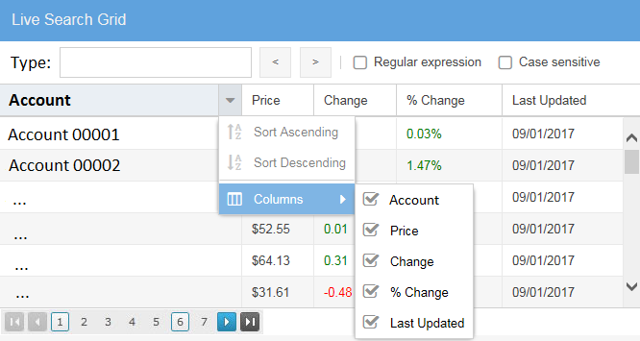






Collections Slice and Dice
Principle: Provide filtering, sorting, field selection and paging for collections.
Client
REST Layer
NEM
Accounts
{
…
offset: …,
size: …,
accountType:…
}
GET
GetAccounts
REQUEST PARAMETERS

Slide 14
Errors and HTTP Statuses
Principle: Handle errors with HTTP status codes.
4XX code for missing resources
5XX code for internal errors
HTTP HEADER
Status : 500
…
Client
REST Layer
NEM
Accounts
HTTP BODY
…
…
…
GET
GetAccounts
POST
CreateAccount

Slide 15








HTTP Methods Override
Principle: Allow overriding HTTP method using custom HTTP header like X-HTTP-Method-Override.
Forces a request to be interpreted as if it was sent with a specific HTTP verb, even if it was actually sent with a different one
HTTP HEADER
X-HTTP-Method-Override : POST
…
Client
REST Layer
NEM
Accounts
HTTP BODY
…
…
…
GET
GetAccounts
POST
CreateAccount

Slide 16
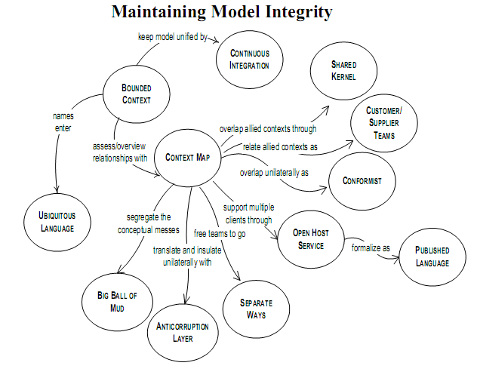
Domain Driven Design
Principle: Follow Domain-driven design.

Slide 17
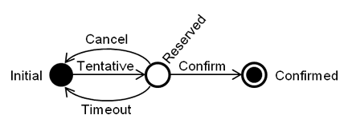






Transactions
Principle: Use Try-Confirm-Cancel pattern for transactions.
Client
REST Layer
NEM
Accounts
{
…
status:tentative/
confirm/
cancel
}
POST
CreateAccounts
REQUEST PARAMETERS

